Slide 1
HSE Officer
Nov 2015

Slide 2
Who is the HSE Officer?
SOP-GEN-2014C
The First Mate is the designated HSE Officer on TDI-Brooks vessels.

Slide 3
What does that mean?
It means the First Mate is responsible for
preventing accidents and injuries and
ensuring HSE policies/ procedures are followed.

Slide 4
How do you do that?
Leadership
Risk Assessment & Mitigation
Compliance
Training
Reporting

Slide 5
Leadership
Lead by example
Communicate with your crew about HSE issues
Take action on HSE issues brought to your attention

Slide 6
Risk Assess & Mitigation
Actively look for hazards
Conduct JSA’s before allowing crew to start tasks
Conduct health and safety inspections: Galley, PPE, Sanitation, Lift Gear

Slide 7
Risk Assess & Mitigation
Use STOP WORK authority
Encourage reporting of HSE issues (Safety Cards, Employee Incident Reports)
Initiate MOC for deviations from standard practices.

Slide 8
Compliance
Maintain SDS Binders
Ensure company procedures are followed.
Review and Follow HSE Bridging documents.

Slide 9
Training
Safety at Sea
Core Safety Training
Weekly HSE topic meeting

Slide 10
Reporting/ Recordkeeping
Incidents- in NS5, attach docs, notify mgmt.
Emergency Drills- NS5 and bridge log
Vessel Orientations- on bridge

Slide 11
Reporting/ Recordkeeping
Weekly Reports- every Friday to HSE@tdi-bi.com.
Risk Reviews- Monthly
Safety Cards- Review at meetings, keep on bridge, track to closure

Slide 12
Reporting/ Recordkeeping
Contractor Safety Meeting- conduct and enter in NS5
Visitors- Sign in & out

Slide 13
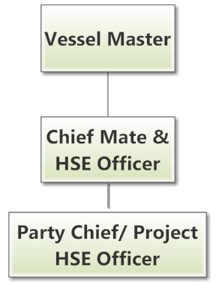
HSE Reporting Chart

Slide 14
Contractors
Lead Contractor Safety Mtg
Show them SDS & hazardous material locations
Notify of any other hazards
Must follow TDI procedures
  Permits, PPE,

